Slide 1


Data Collection
Dan Brigden, WHO HQ

Slide 2
EVM OVERVIEW
EVM is primarily an online solution (requires internet connection), although data-collection can operate both online and offline.
1
2
3
2
COUNTRY SET-UP
DATA COLLECTION
GLOBAL ANALYSIS
GLOBAL ANALYSIS
EVM Assessment Manager
(website)
THE ADMINISTRATION TOOL
EVM Locations
(mobile app)
THE DATA-COLLECTION TOOL
EVM Global Dashboard
(website)
GLOBAL DATA ANALYSIS
EVM Locations
(mobile app)
THE DATA-COLLECTION TOOL
* All will be released in EN, FR, ES and more will come later, including RTL languages

Slide 3

EVM LOCATIONS
2
EVM Locations (mobile app)
THE DATA-COLLECTION TOOL
Used to complete location questionnaires.
For iOS, Android 6+, and Windows 10+ devices; designed for tablets but will work on mobile phones or Windows PCs.
Free download. Once the app is installed and opened for the first time, no internet connection is necessary.
No authentication necessary to use the app to create “standalone” (unassigned) questionnaires.
Distribution and collection of questionnaires can be performed in online (upload) or offline (memory stick) mode.

Slide 4
EVM ASSESSOR – WORKFLOW
DOWNLOAD QUESTIONNAIRE
ADMINISTER QUESTIONNAIRE
UPLOAD QUESTIONNAIRE
Assessors can download any questionnaire they have been assigned directly into the app with:
An internet connection
Their EVM username and password
Once they are authenticated, they see a list of assigned location questionnaires and can download them on to the app.
Authentication is only necessary to download questionnaires; once they are on the device any user can view/edit them.

Slide 5
EVM ASSESSOR – WORKFLOW
DOWNLOAD QUESTIONNAIRE
ADMINISTER QUESTIONNAIRE
UPLOAD QUESTIONNAIRE
Questions and Requirements
Questions are asked in order to assess whether a requirement has been met.
Requirements are used to score categories and criteria.
The relationship between questions and requirements can be seen in the app. If an assessor is confused by why a question is being asked, it can help to find out which requirement is being assessed.
Guidance on individual questions is also provided.

Slide 6
EVM ASSESSOR – WORKFLOW
DOWNLOAD QUESTIONNAIRE
ADMINISTER QUESTIONNAIRE
UPLOAD QUESTIONNAIRE
A note on applicability
There are 1,423 questions. No single facility will ever encounter this number, because only applicable questions are asked.
Question applicability is determined by:
Supply chain level
Answers to previous questions
This increases the efficiency of data-collection.

Slide 7
EVM ASSESSOR – WORKFLOW
DOWNLOAD QUESTIONNAIRE
ADMINISTER QUESTIONNAIRE
EXPORT QUESTIONNAIRE
Assessors can export questionnaires as a file to share with other assessors/EVM managers using a memory stick, email, and Bluetooth.
Once the file has been received, it can be imported directly into the app.
No internet connection is necessary for exporting and importing questionnaires.
Same as EVMA 1.0.

Slide 8
EVM ASSESSOR – WORKFLOW
DOWNLOAD QUESTIONNAIRE
ADMINISTER QUESTIONNAIRE
UPLOAD QUESTIONNAIRE
Assessors can upload questionnaires from the app to the EVM Assessment Manager with:
An internet connection
EVM username and password
Once authenticated, the questionnaire will be uploaded directly. The country administrator will receive an alert to notify him/her that a questionnaire has been received and is available for review.

Slide 9
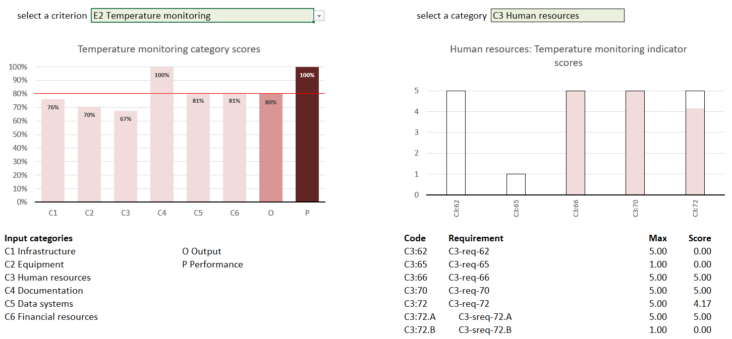
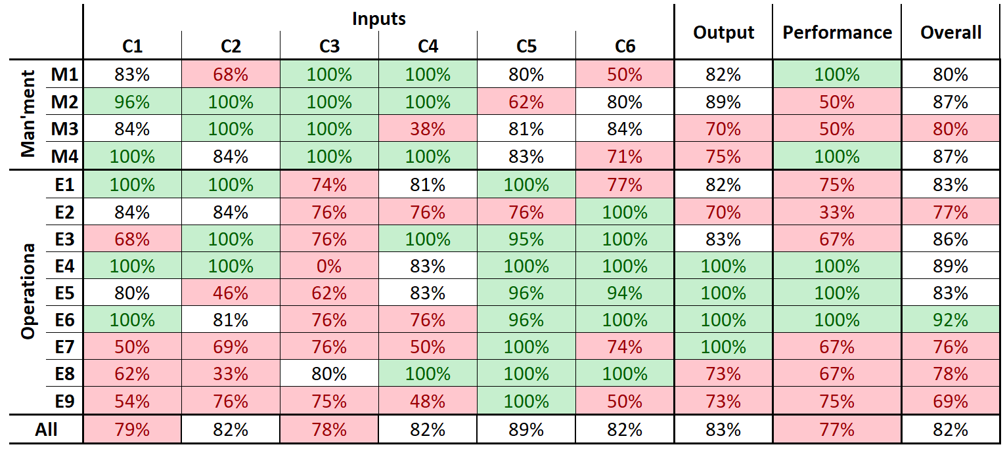
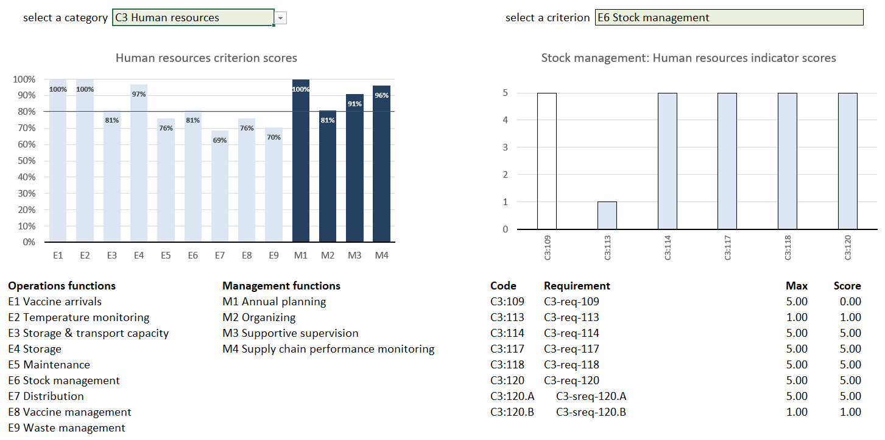
App Dashboard
EVM ASSESSOR – WORKFLOW
Questionnaire results can be viewed directly in the app.

Slide 10

EVM ASSESSOR – WORKFLOW
DOWNLOAD QUESTIONNAIRE
ADMINISTER QUESTIONNAIRE

Slide 11

Thank you

